Slide 1
TEST UR IQ
Jagadish Rathod
Sarthak Shivaraj
Vinod Kumar NB

Slide 2
ABSTRACT
Test ur IQ is an android application where users can test their IQ by answering five multiple choice questions and accordingly their IQ score will be calculated.
Each of the five random questions will have a timer of 10 seconds.

Slide 3
EXISTING APPLICATIONS
THERE ARE SO MANY IQ TEST APPLICATIONS AVAILABLE IN PLAY STORE WHICH MOTIVATED US TO TAKE THIS TOPIC FOR OUR PROJECT.

Slide 4
APPLICATION
The user will be welcomed with a welcome screen.
If the user is playing for first time, he will be asked to login with name and password.
He cannot login if name or password is empty.
Then the home screen arrives with user name displayed on the activity.

Slide 5
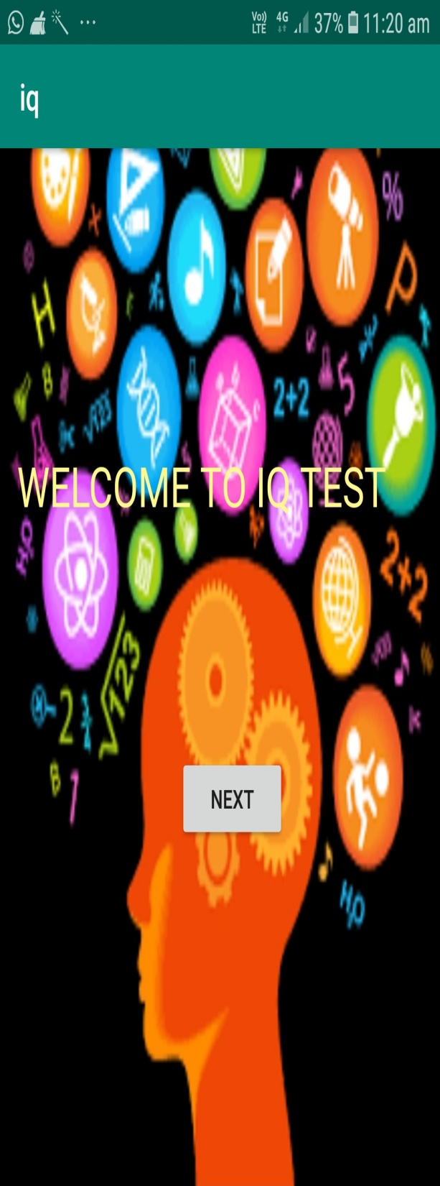
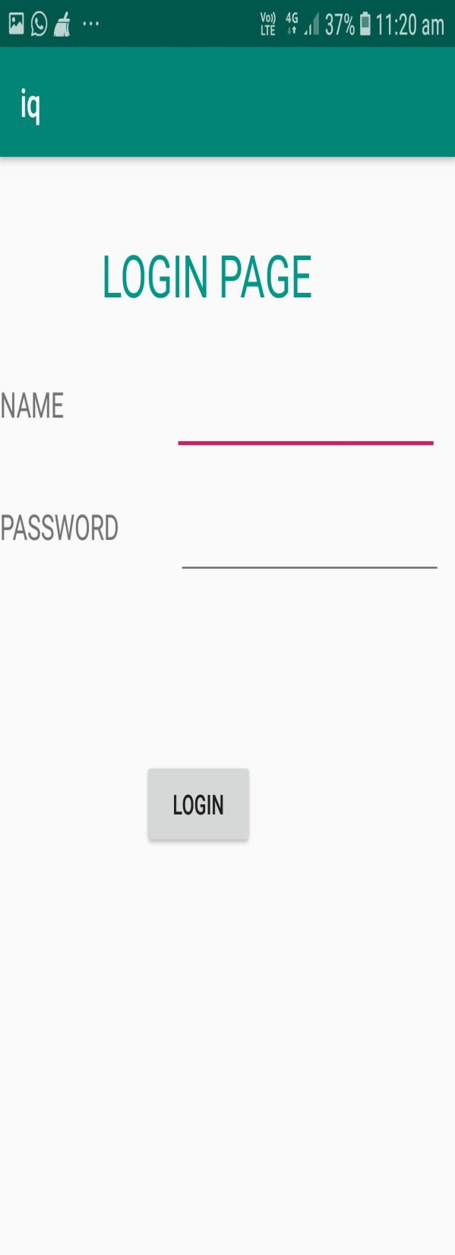
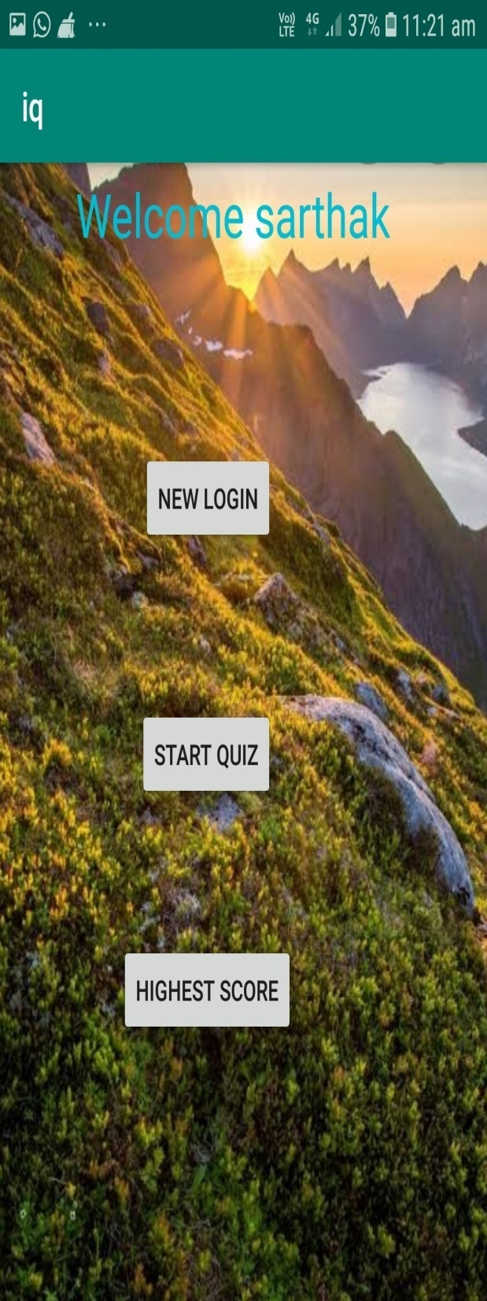
.

Slide 6
LOGIN AND HOME SCREEN
On subsequent opening of the app, the user will automatically go to home screen without login .
If the user name is not the one displayed on the home screen then he/she can login with his/her name.
Home screen has three buttons for login , starting the quiz and displaying the highest scorer.
In highest scorer activity the top scorer’s name and score will be displayed.

Slide 7
QUIZ ACTIVITY
50 questions are stored where 5 questions are randomly selected for the user to answer.
Each question has a time limit of 10 seconds.
Scores for each question depends on how quickly the user answers each question.
No question once asked will be repeated.
Sound effects for correct and wrong answers have been added for effectiveness.
The user must select one option for each question.
No points are questions answered after time limit.

Slide 8
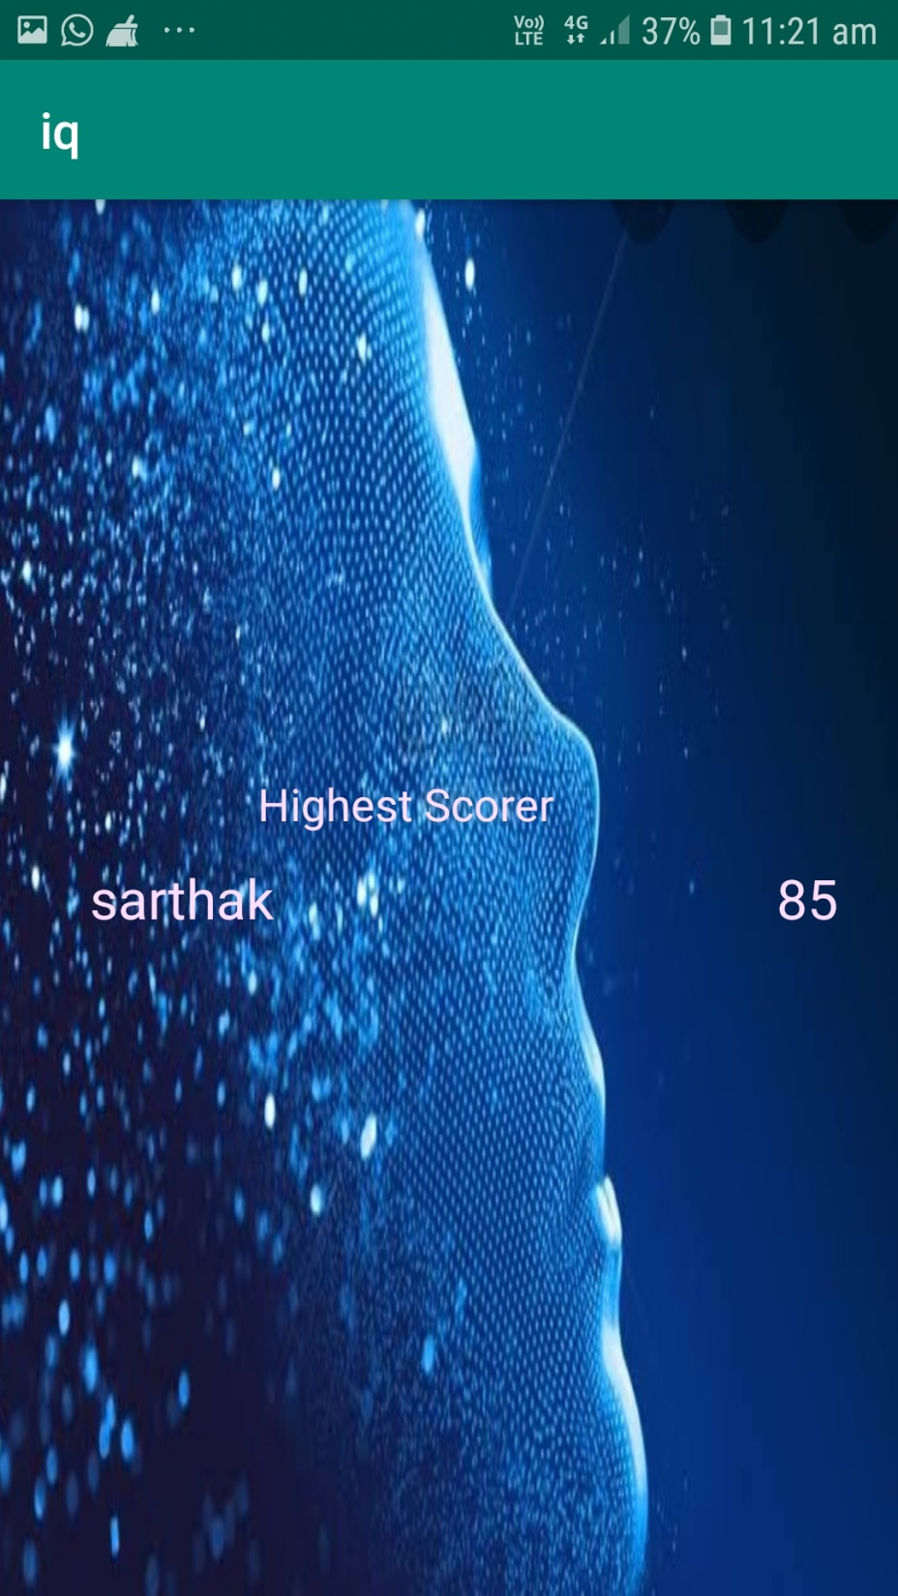
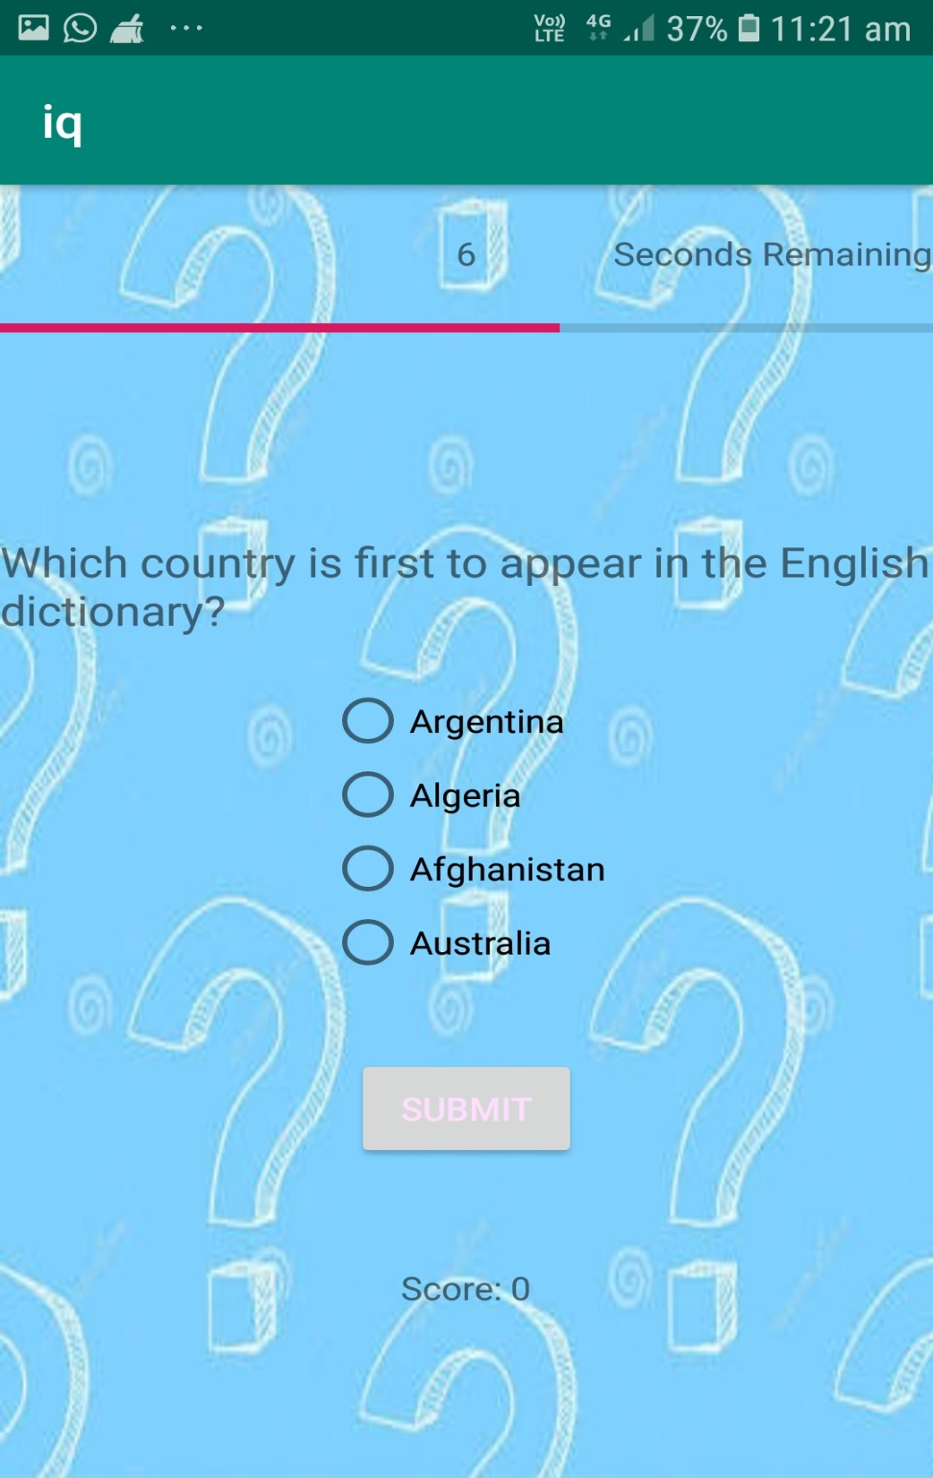
.

Slide 9
FINAL SCORE SCREEN AND GRAPH
After the quiz is completed , the user arrives in this screen where his final score will be displayed.
If his/her score is the highest , it will be displayed in this screen.
The user’s level of IQ will also be displayed as HIGH, AVERAGE or POOR based on his score.
This activity has two buttons to view his score in a bar graph and to go back to home screen.
In graph screen, a bar chart will be displayed based on the user’s IQ score.

Slide 10
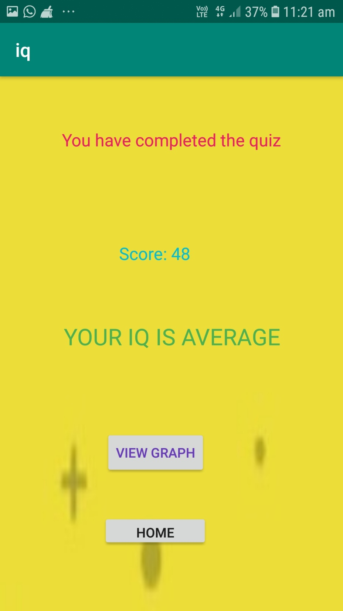
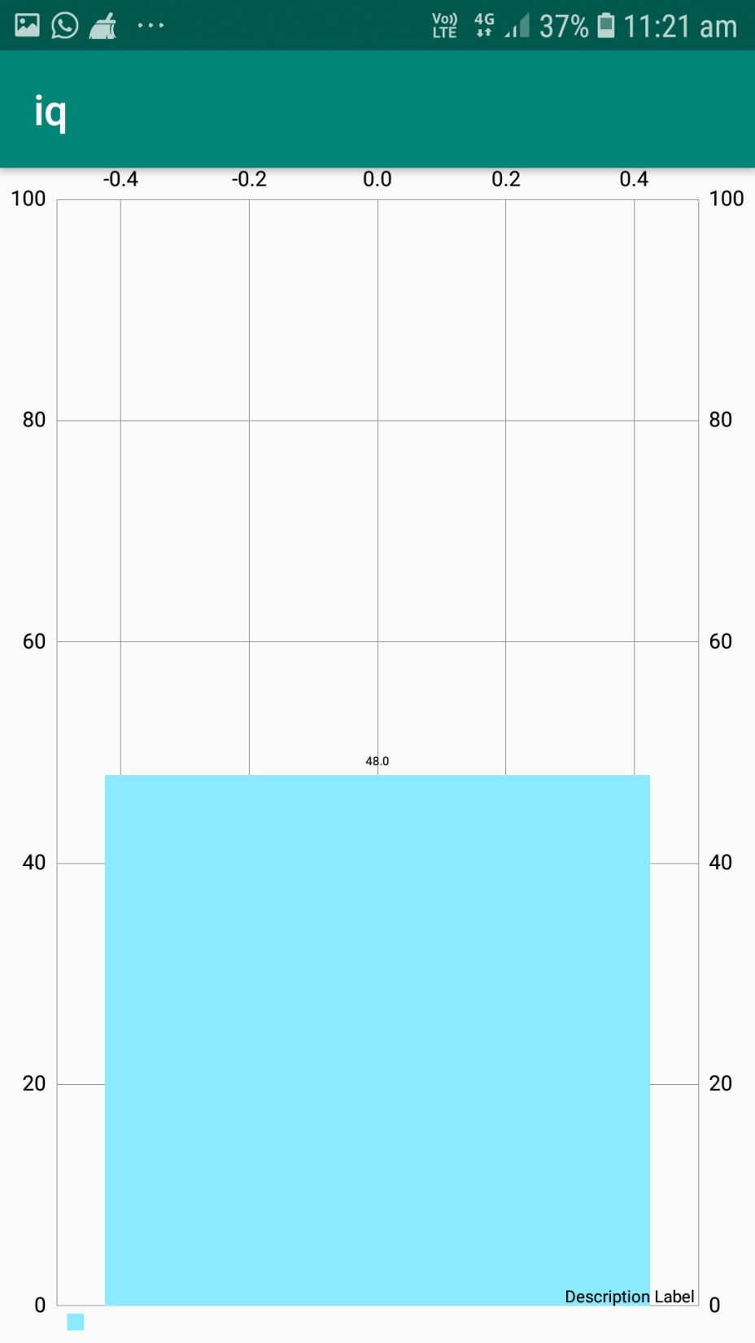

Slide 11
INNOVATION
Timer for each question
Sound effects for correct and wrong answers.
Score will be based on how quickly the user correctly answers the questions.
Graphical analysis of the user’s IQ score.

Slide 12
WHAT WE LEARNT
Proper usage of data persistence using databases.
Adding music files to studio
Adding timer to programs
Adding bar charts in android apps.

Slide 13
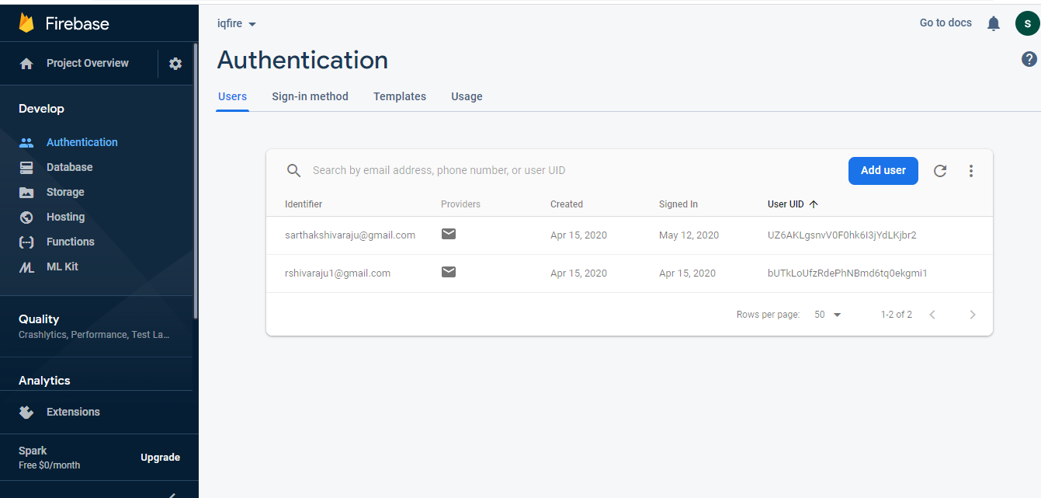
UPDATES
User Authentication with Firebase
Login and Logout

Slide 14
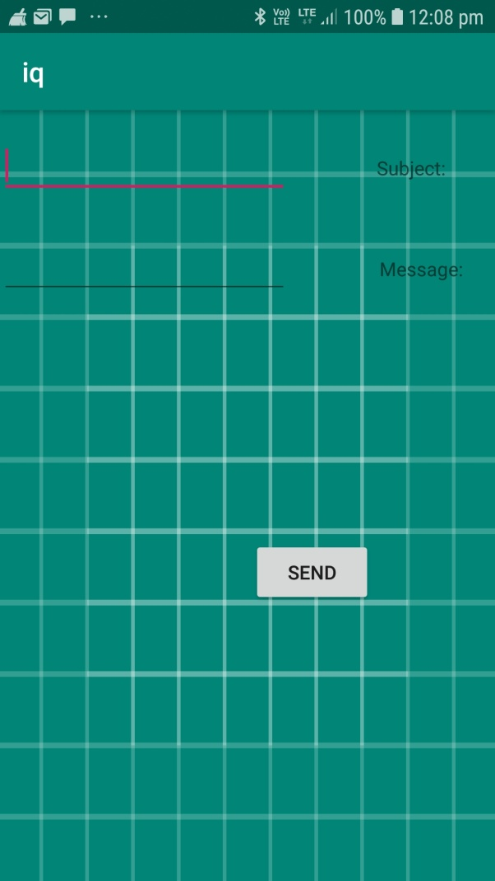
Feedback
Users after playing the quiz can provide their valuable feedback to us via gmail.

Slide 15
MESSAGING
The final score obtained by the user can be messaged to his/her phone number so that he can refer to his scores.

Slide 16
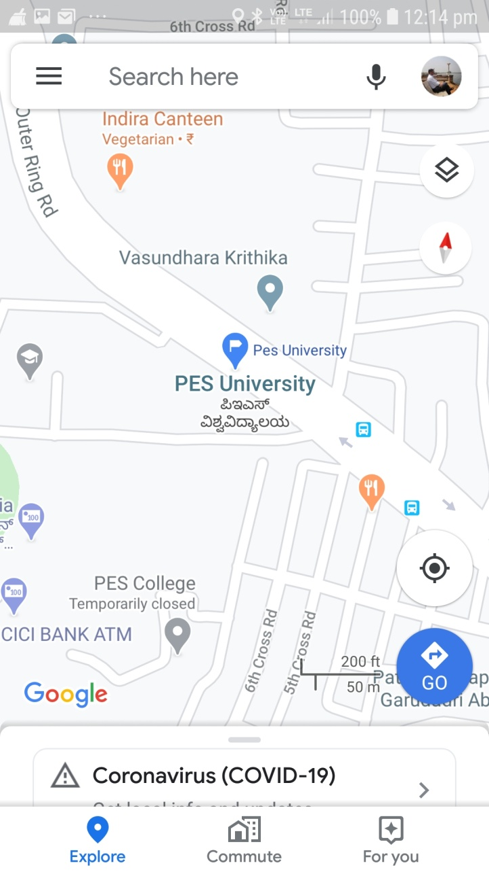
Location
Users can directly meet us by viewing our university location via Google Maps.

Slide 17
THANK YOU
.

